Slide 1
Program an algorithm that given any two equivalent statements, transforms the one statement into the other using a set of equivalence rules
Nutchanon Yongsatianchot

Slide 2
Introduction
Checking that two logic statements are equivalent is NP-hard.
Given any two logic statements F1 and F2. Connect this two statements with ↔, F1↔F2, and transforms this form to Conjunctive Normal Form (CNF). Now, this problem will be the same as SAT which is NP-hard.
Given any two equivalent statements, transforms the one statement into the other is a search problem and probably harder than checking version.

Slide 3
Method
One way to solve this problem is to transform both statements into the same statement.
We could simultaneously search both A and B using pattern matching and transform them until they both reach the same statement. However, this may lead to too much work. Instead, I decide to transform both of them into simplest CNF.
A
B
A
C
B
C
C

Slide 4
Check well form formula
Eliminate →, ↔ using implication and equivalence, respectively
Converse the formula to Negative Normal Form using Demorgan and double negation
Converse NNF to CNF using distribution v over ʌ
Simplifies CNF using Idempotence, Complement, Identity, Annihilation, Absoprtion, Reduction and Adjacency
Do these for both formulas.

Slide 5
Format
∧ = &&
∨ = ||
→ = ->
↔ = <->
¬ = !
⊤ = T , ⊥ = F
Atomic variable = a-z , A-Z (case sensitive)
No space between anything
For example, p v q = p||q , p→q = p->q , p ↔ q = p<->q

Slide 6
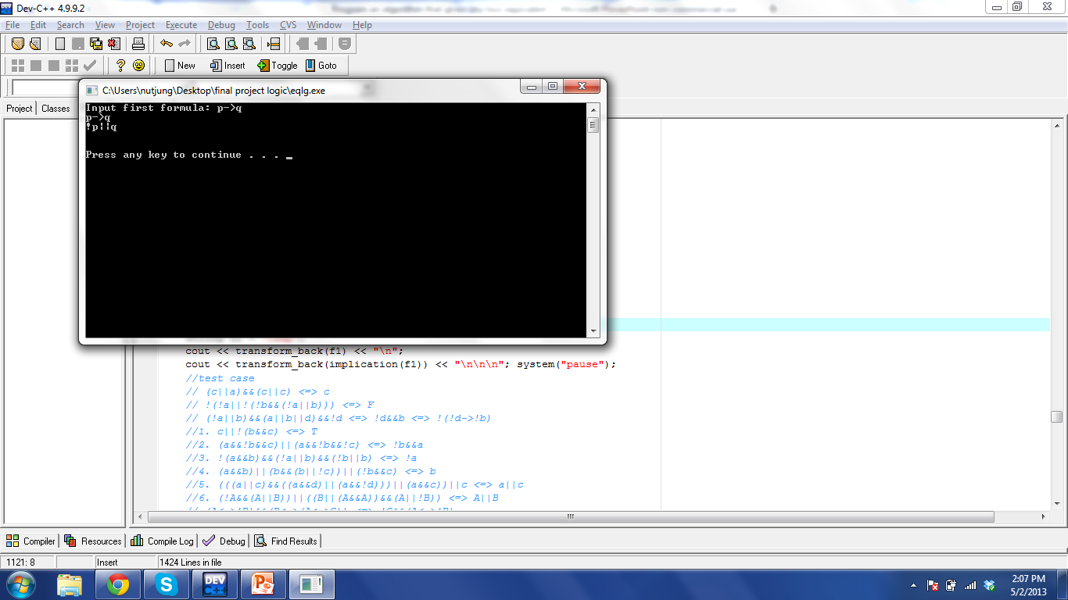
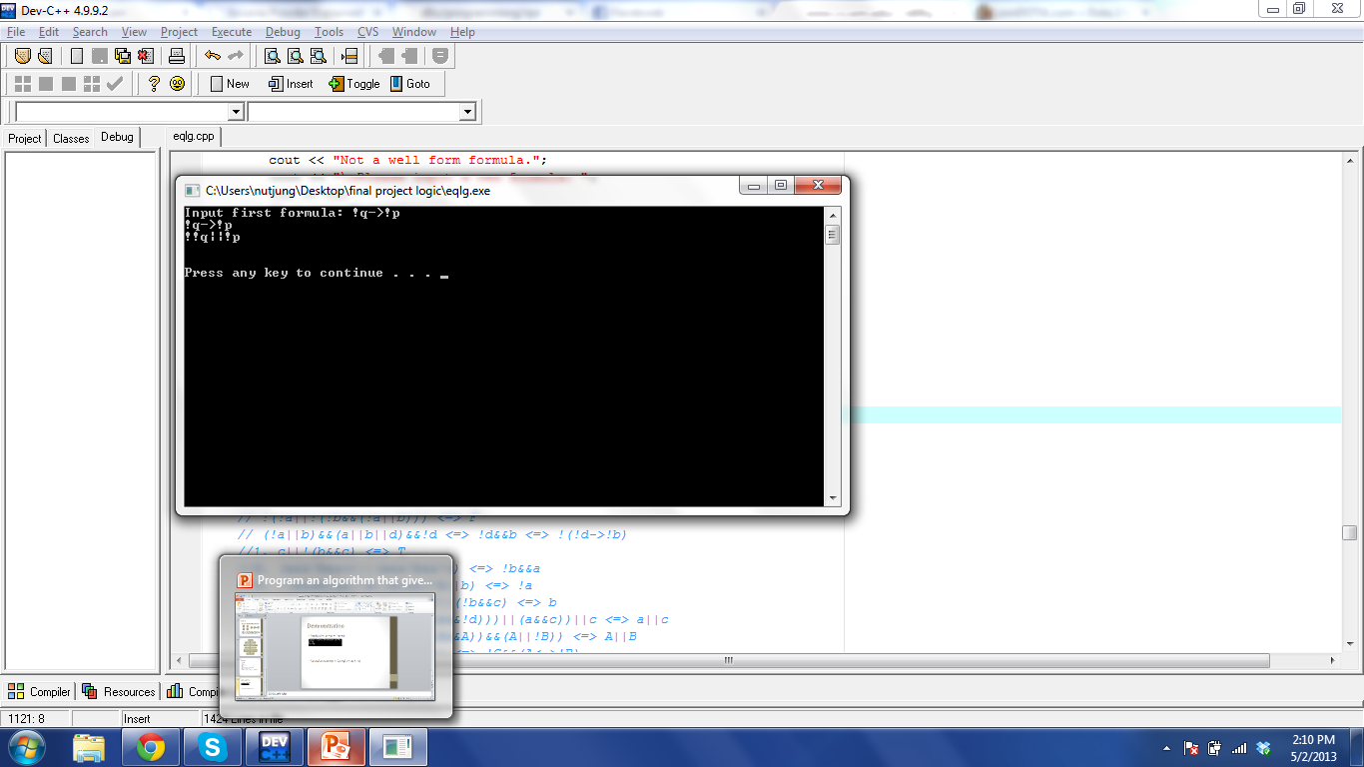
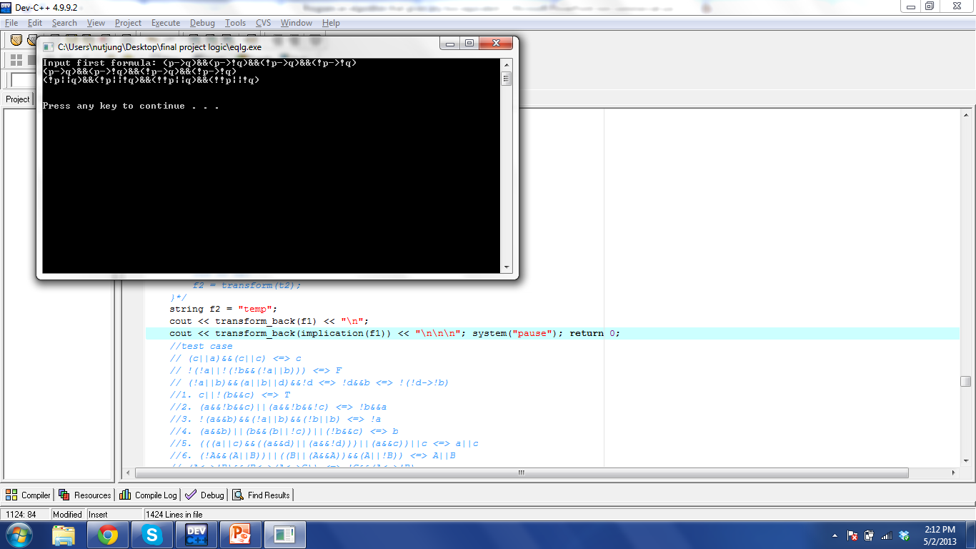
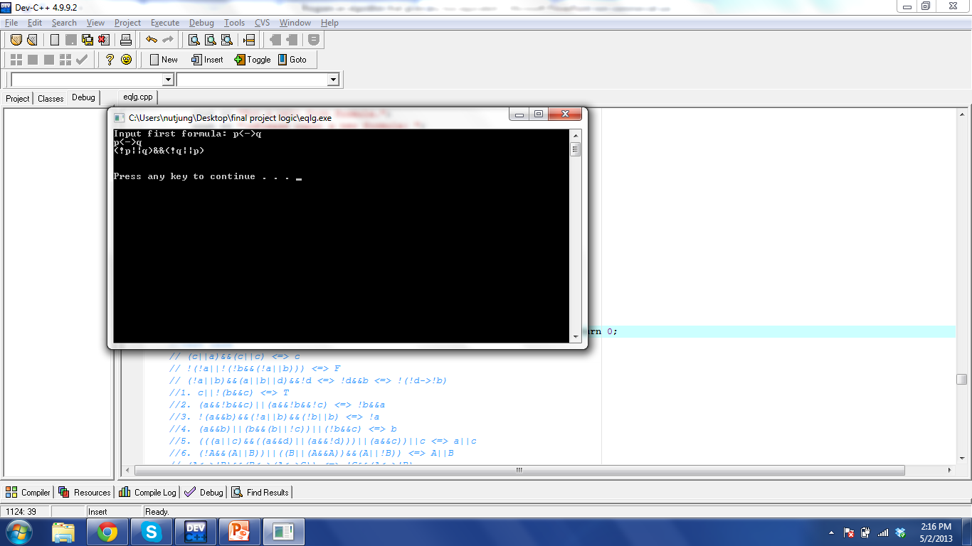
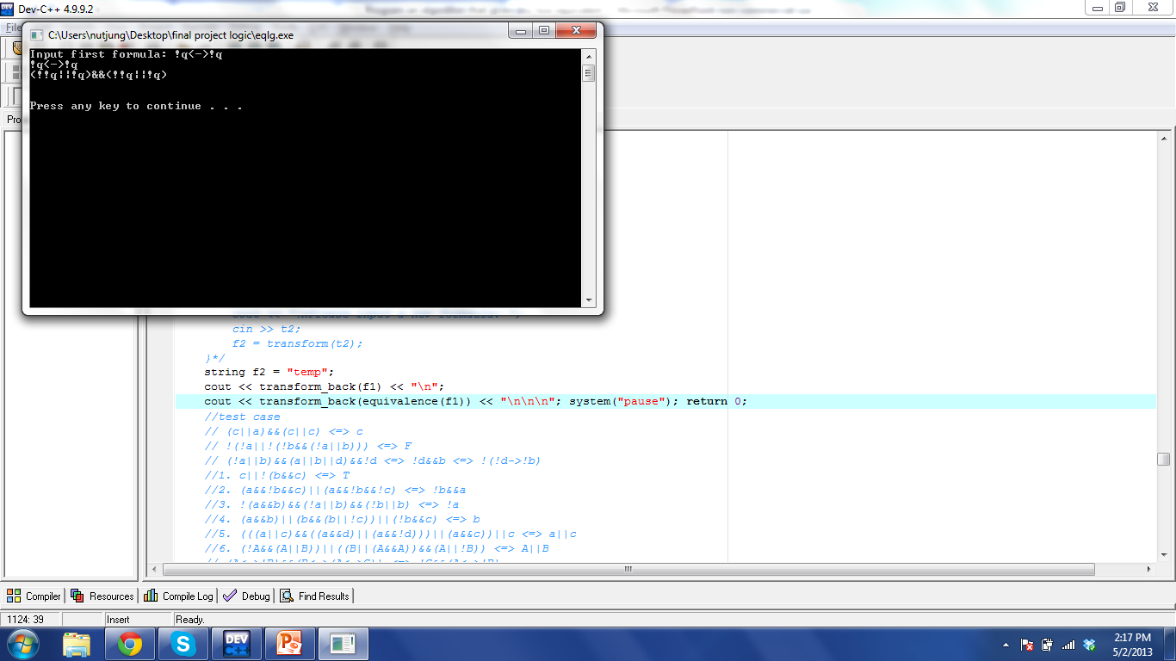
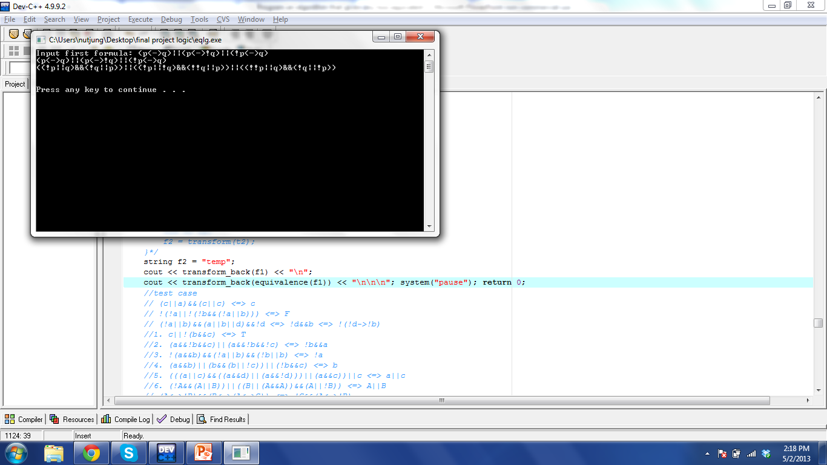
Demonstration
Implication ϕ→ ψ ⇔ ¬ϕ ∨ψ
Equivalence ϕ↔ψ ⇔ (ϕ ∧ψ) ∨ (¬ϕ ∧ ¬ψ)

Slide 7
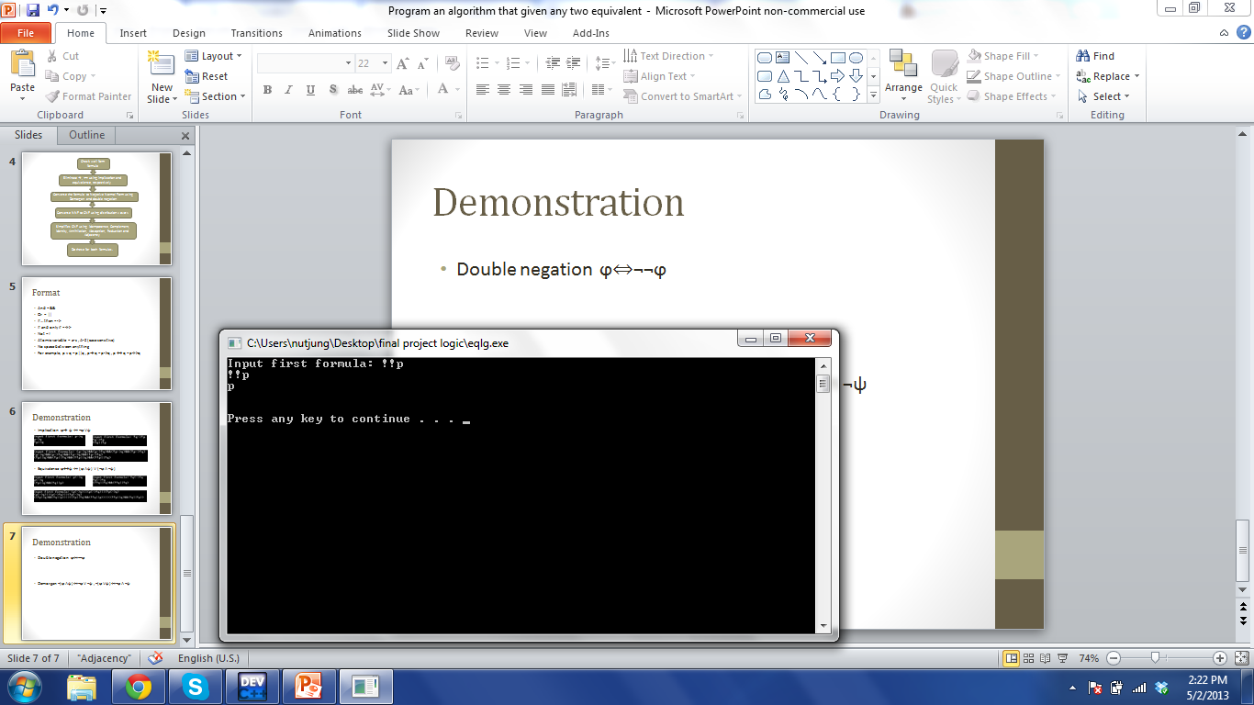
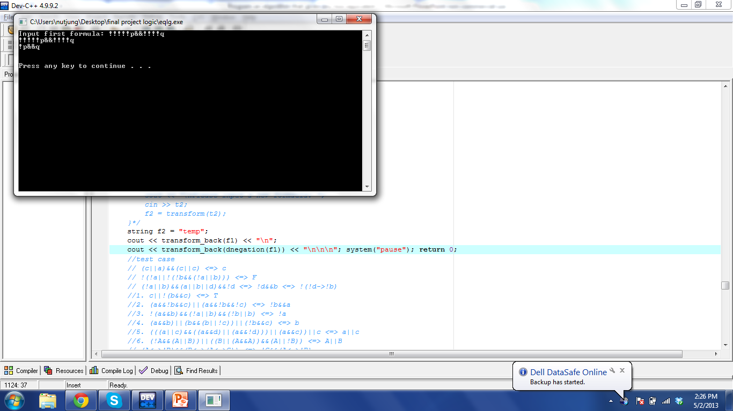
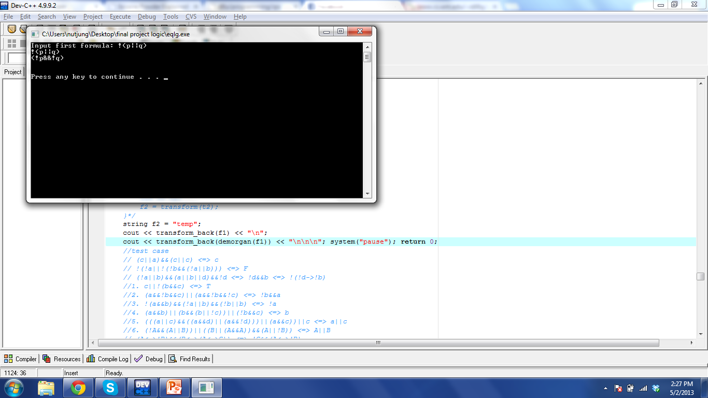
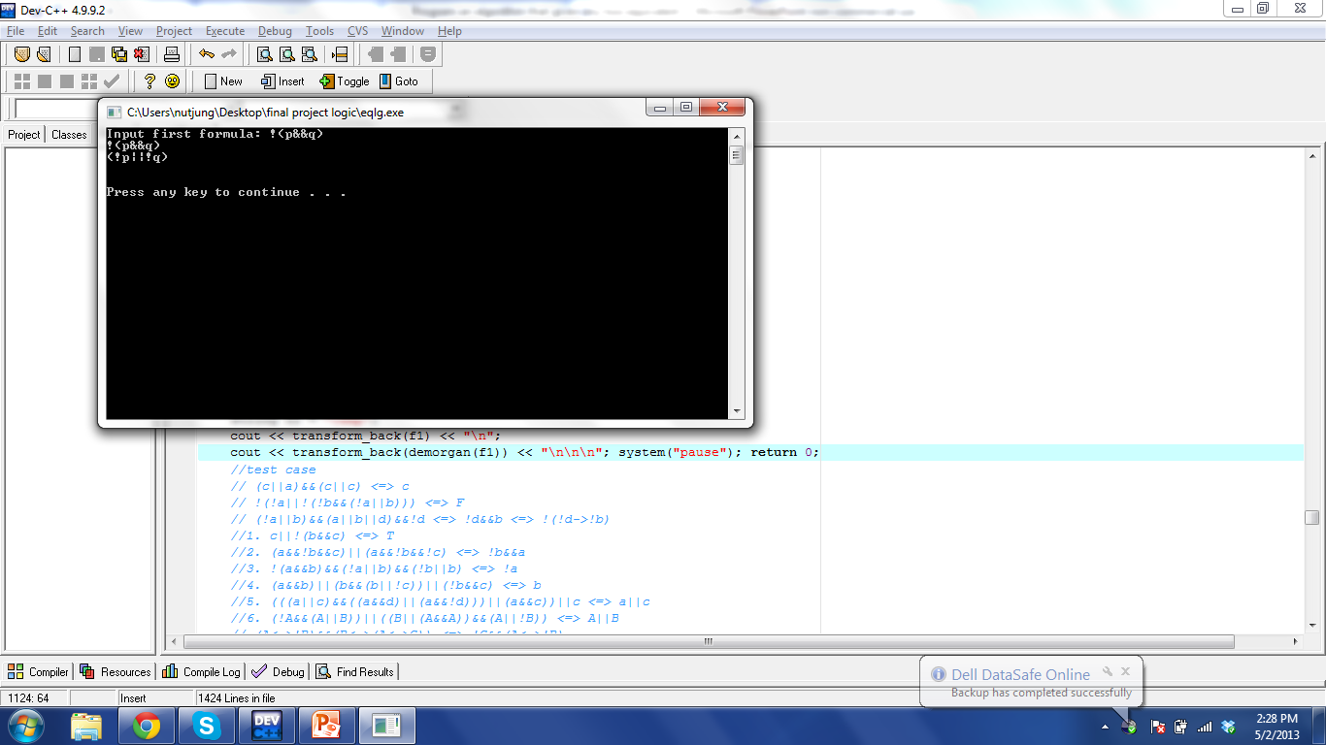
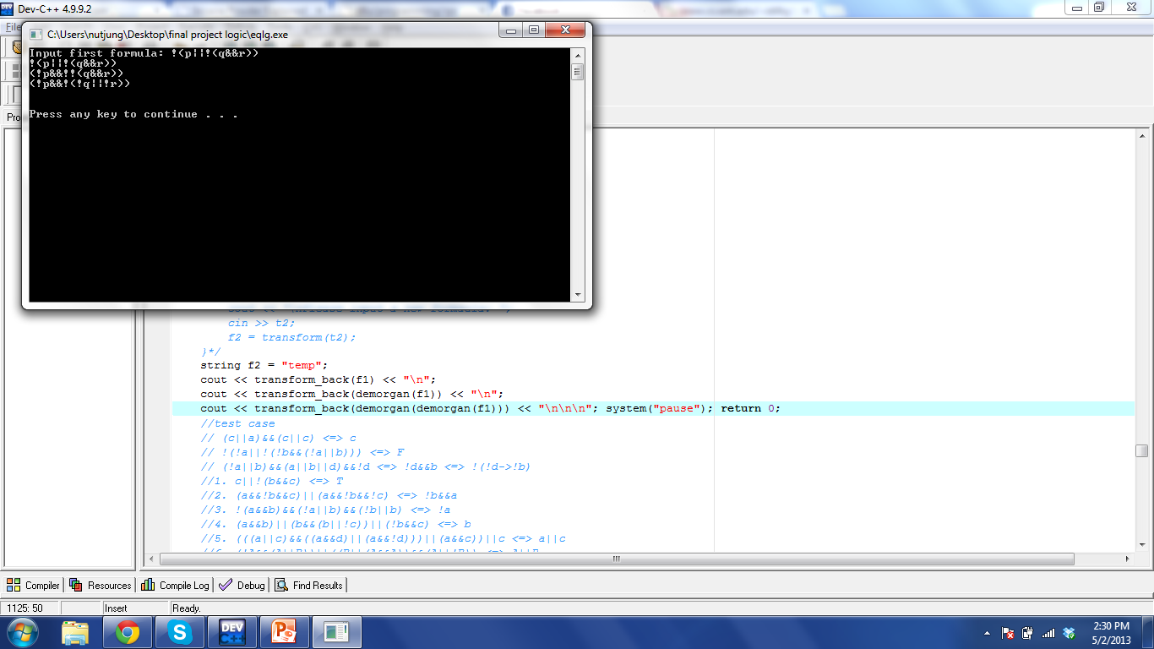
Demonstration
Double negation ϕ⇔¬¬ϕ
Demorgan ¬(ϕ ∧ψ)⇔¬ϕ ∨ ¬ψ , ¬(ϕ ∨ψ)⇔¬ϕ ∧ ¬ψ

Slide 8
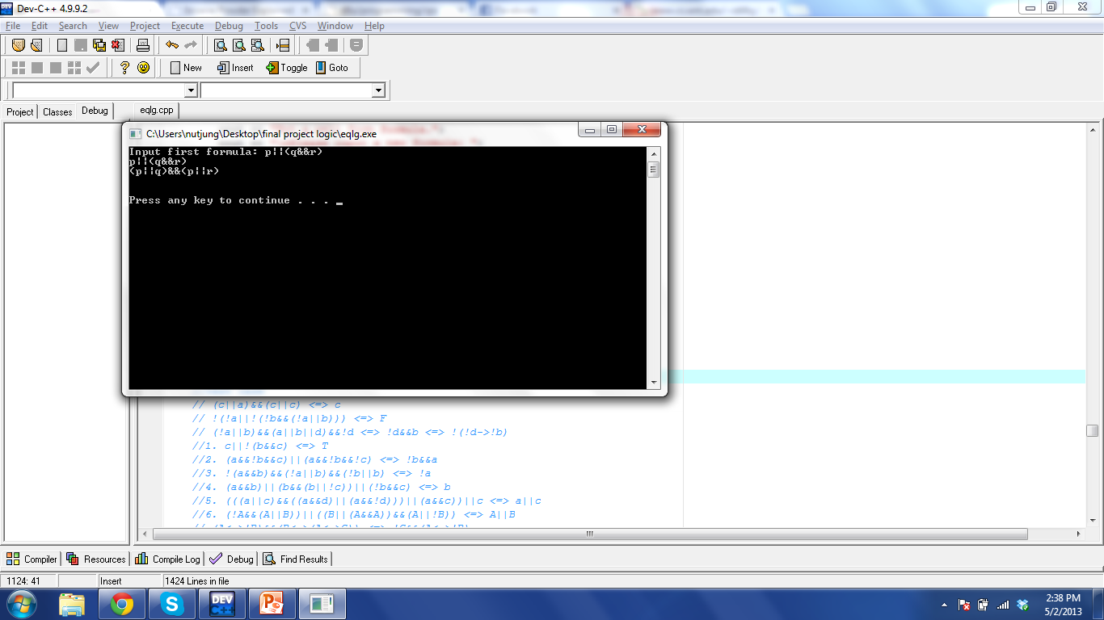
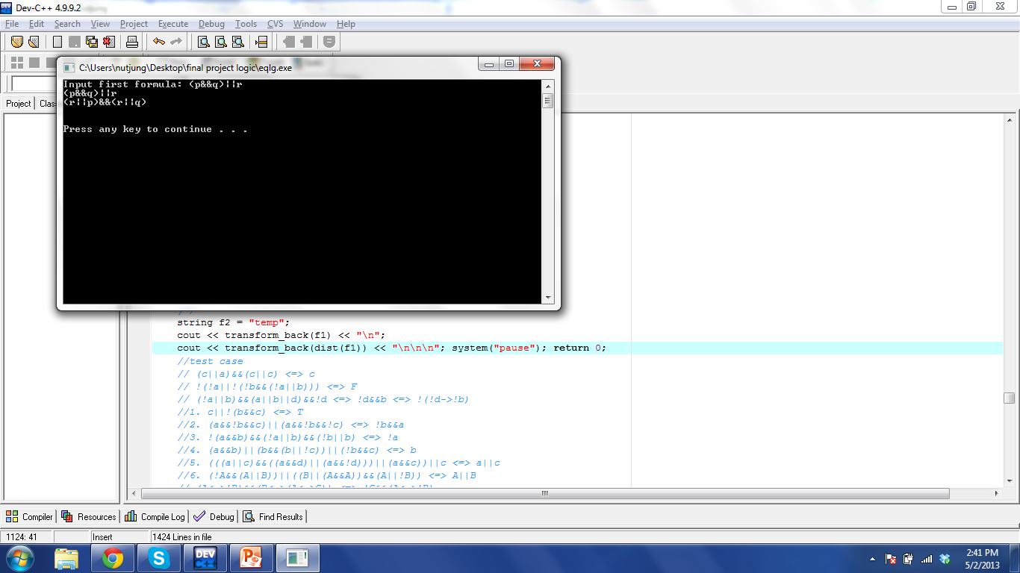
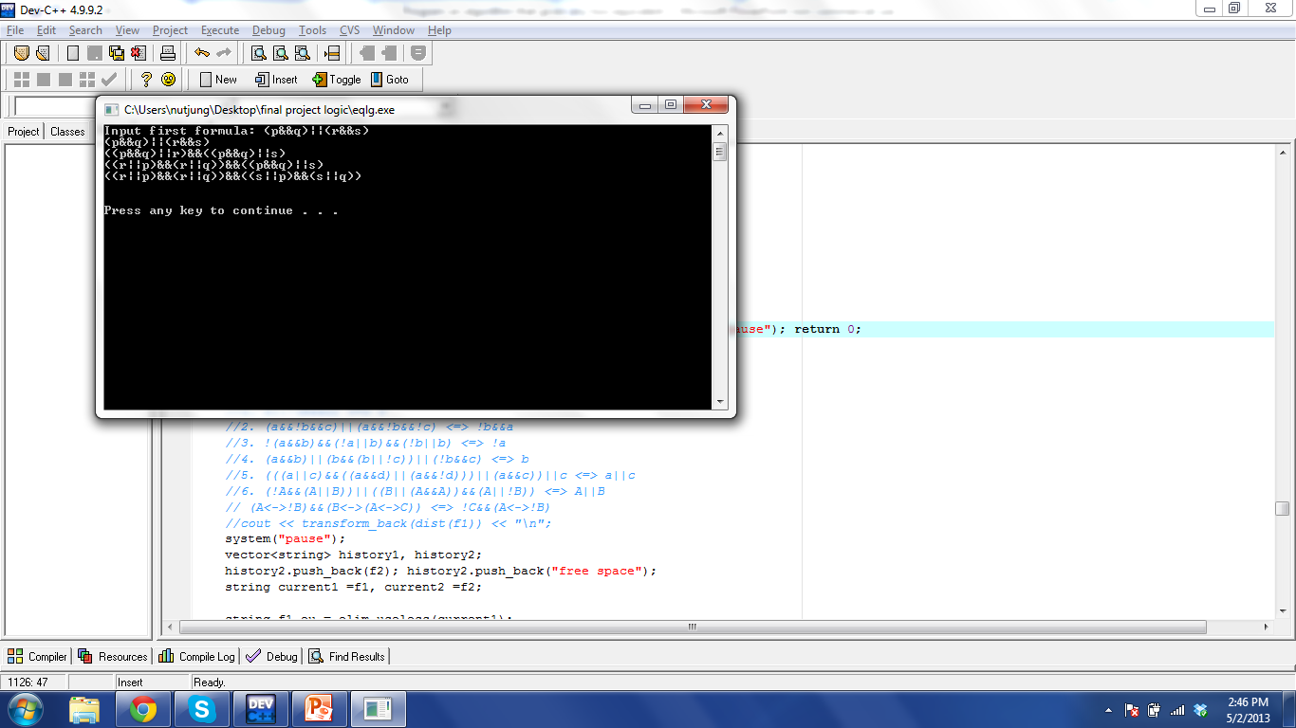
Demonstration
Distribution ϕ ∨ (ψ∧ λ)⇔(ϕ ∨ψ) ∧ (ϕ ∨ λ)

Slide 9
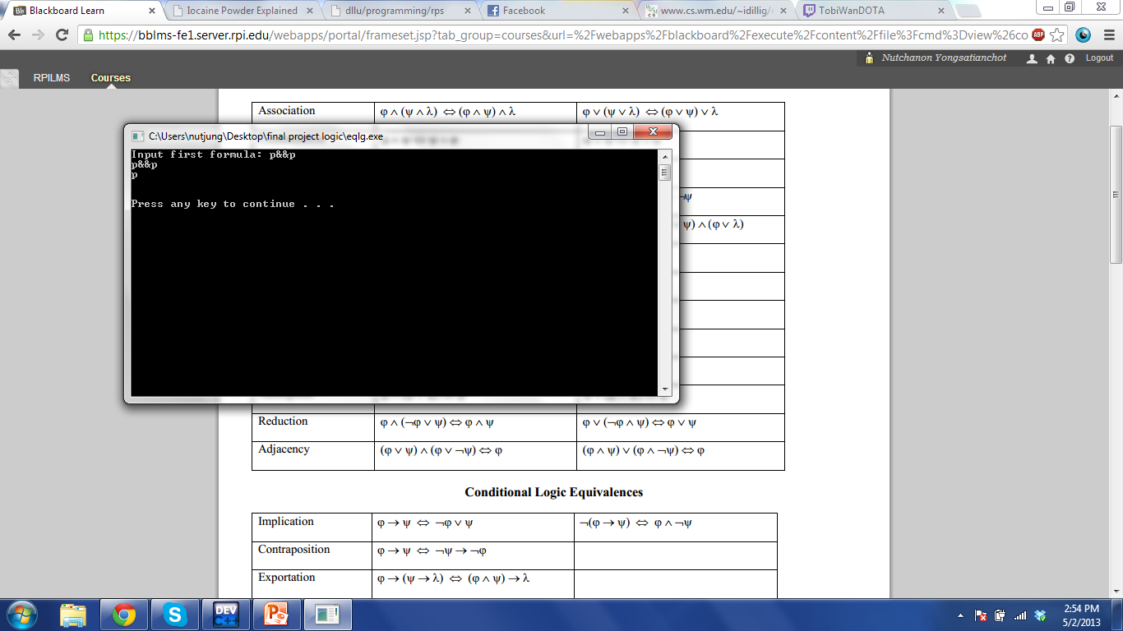
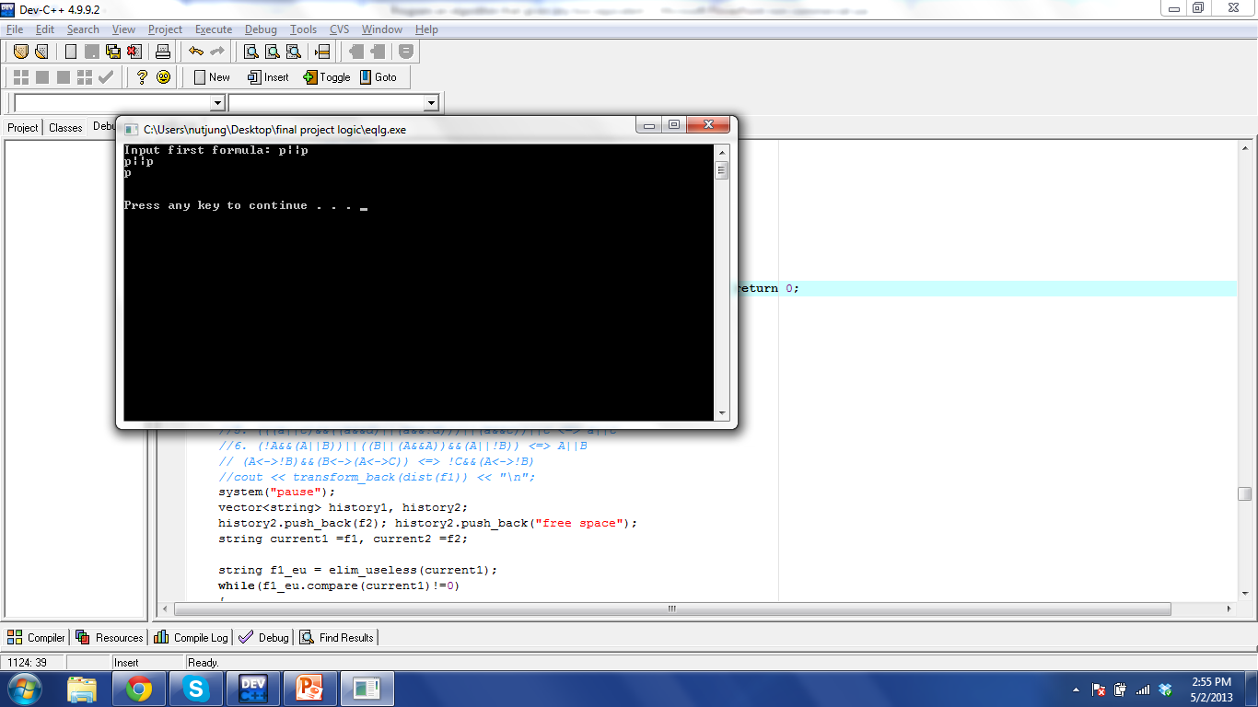
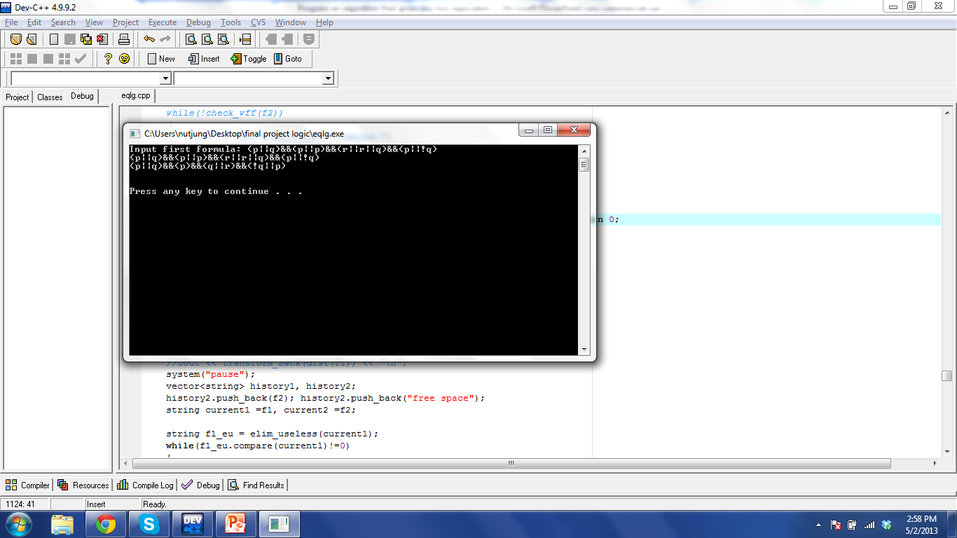
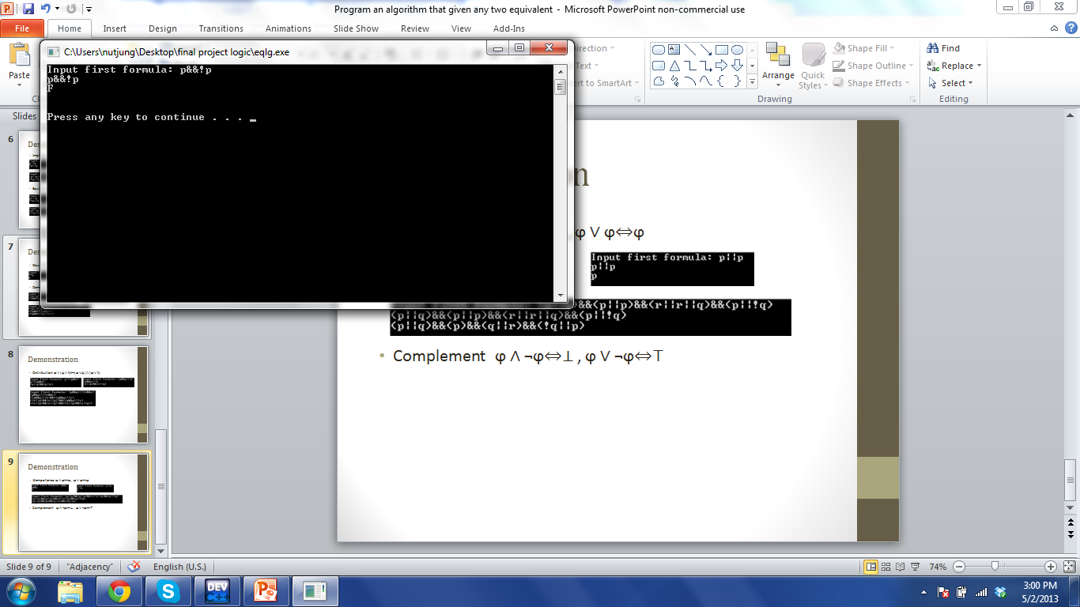
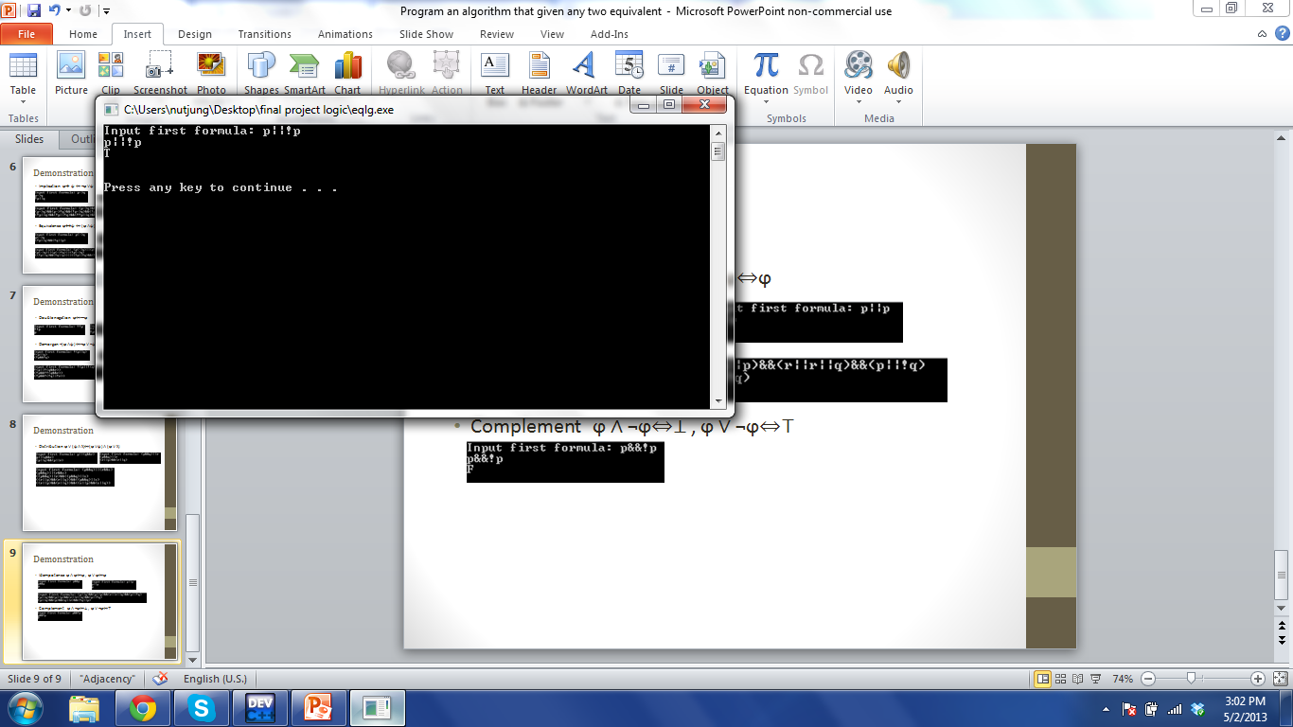
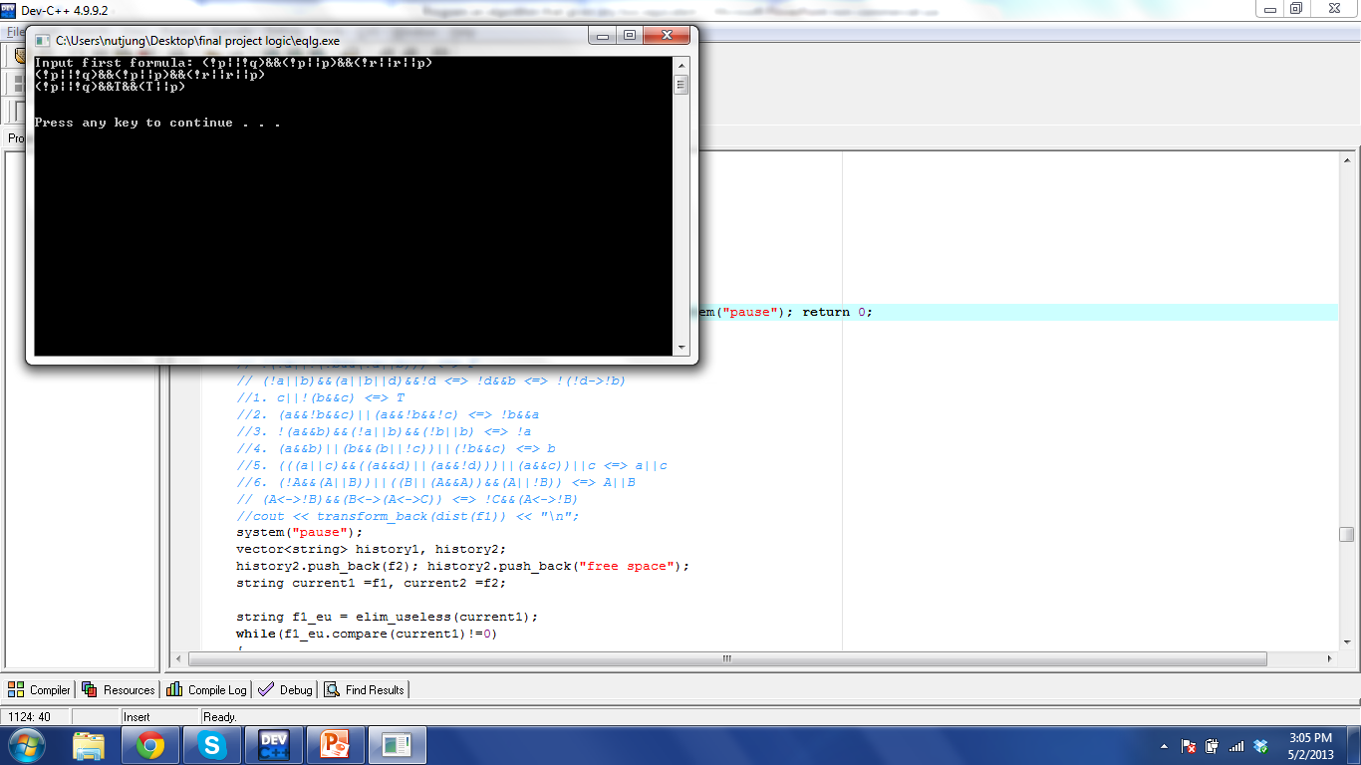
Demonstration
Idempotence ϕ ∧ ϕ⇔ϕ , ϕ ∨ ϕ⇔ϕ
Complement ϕ ∧ ¬ϕ⇔⊥ , ϕ ∨ ¬ϕ⇔⊤

Slide 10
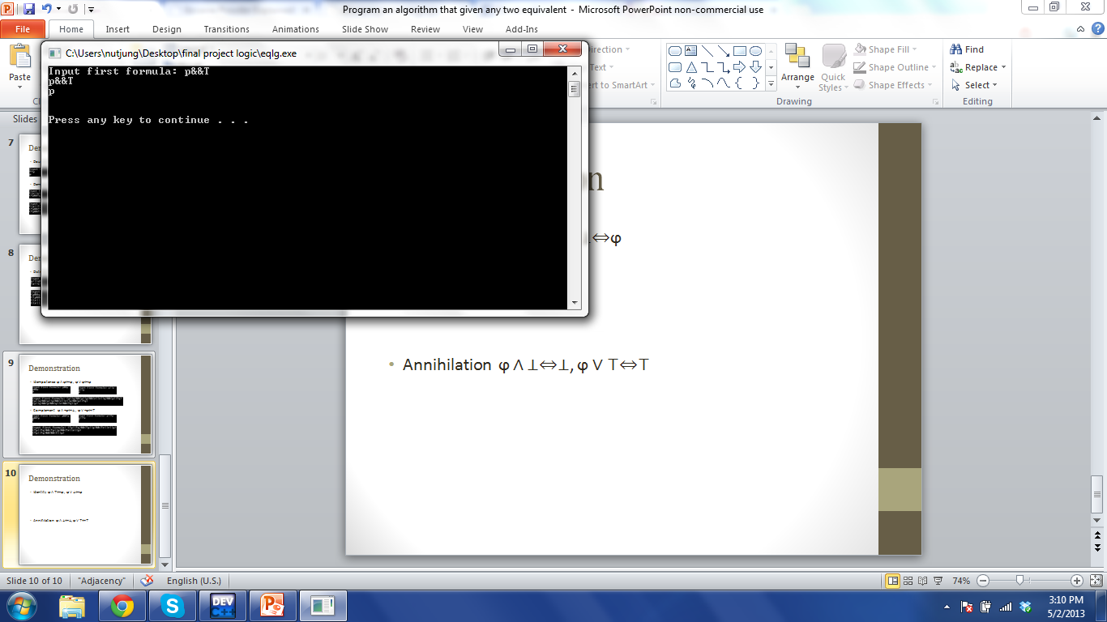

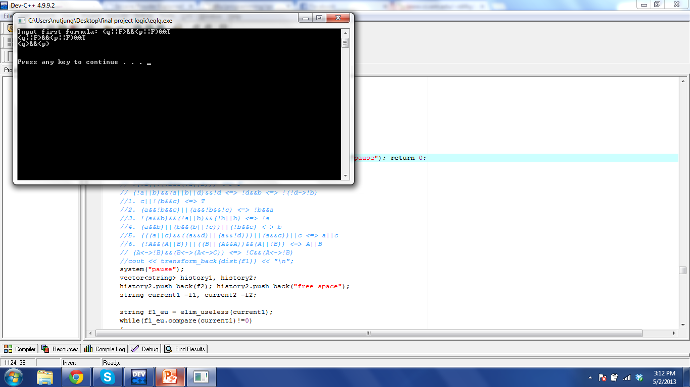
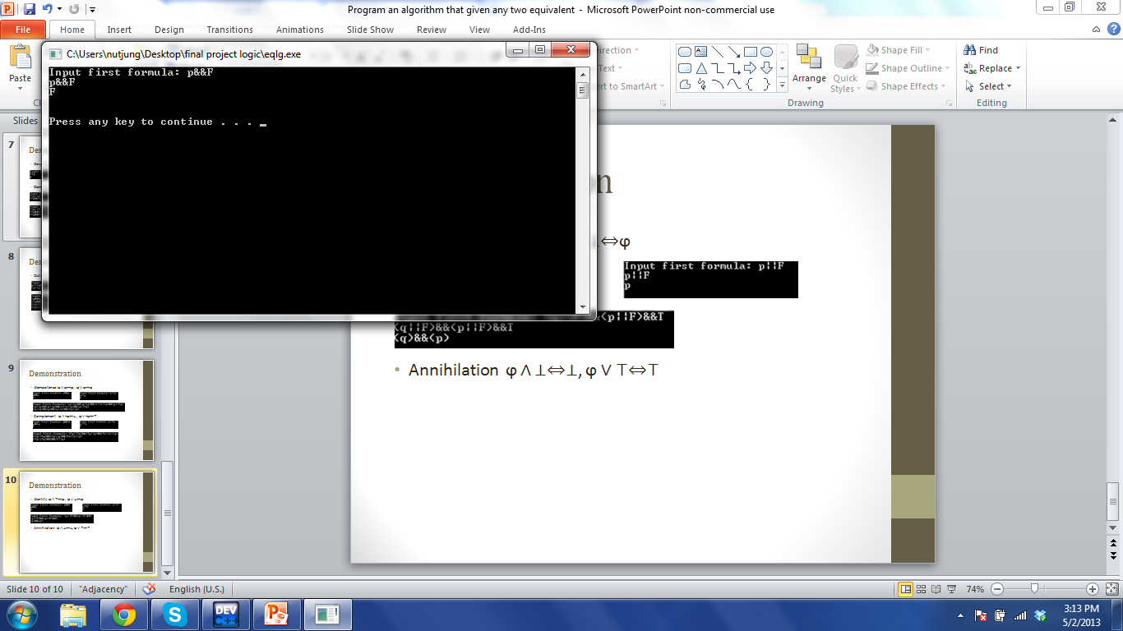
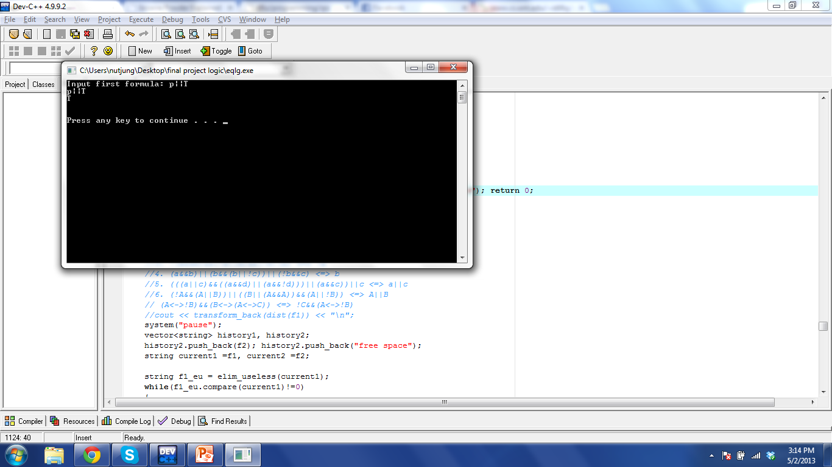
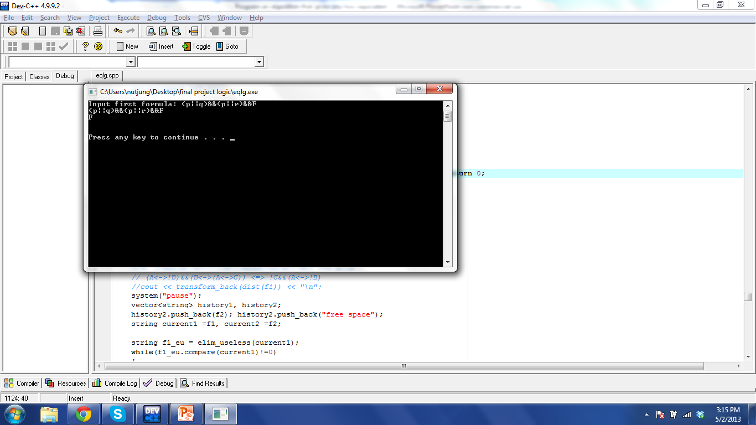
Demonstration
Identity ϕ ∧ ⊤⇔ϕ , ϕ ∨ ⊥⇔ϕ
Annihilation ϕ ∧ ⊥⇔⊥, ϕ ∨ ⊤⇔⊤

Slide 11

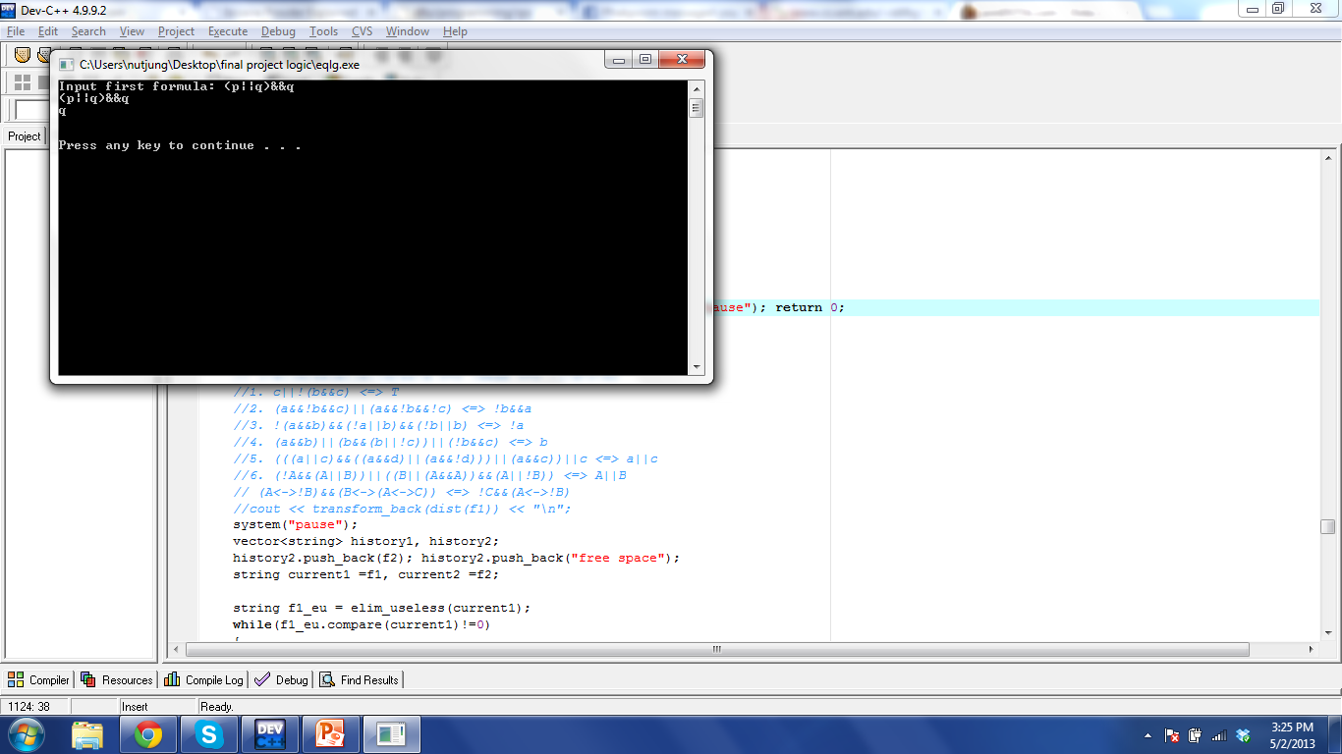
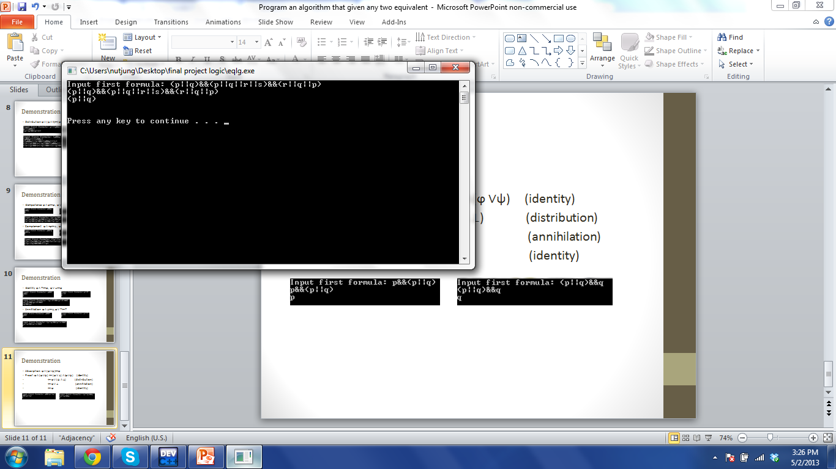
Demonstration
Absorption ϕ ∧ (ϕ ∨ψ)⇔ϕ
Proof: ϕ ∧ (ϕ ∨ψ) ⇔ (ϕ ∨ ⊥) ∧ (ϕ ∨ψ) (identity)
⇔ ϕ ∨ (ψ ∧ ⊥) (distribution)
⇔ ϕ ∨ ⊥ (annihilation)
⇔ ϕ (identity)

Slide 12
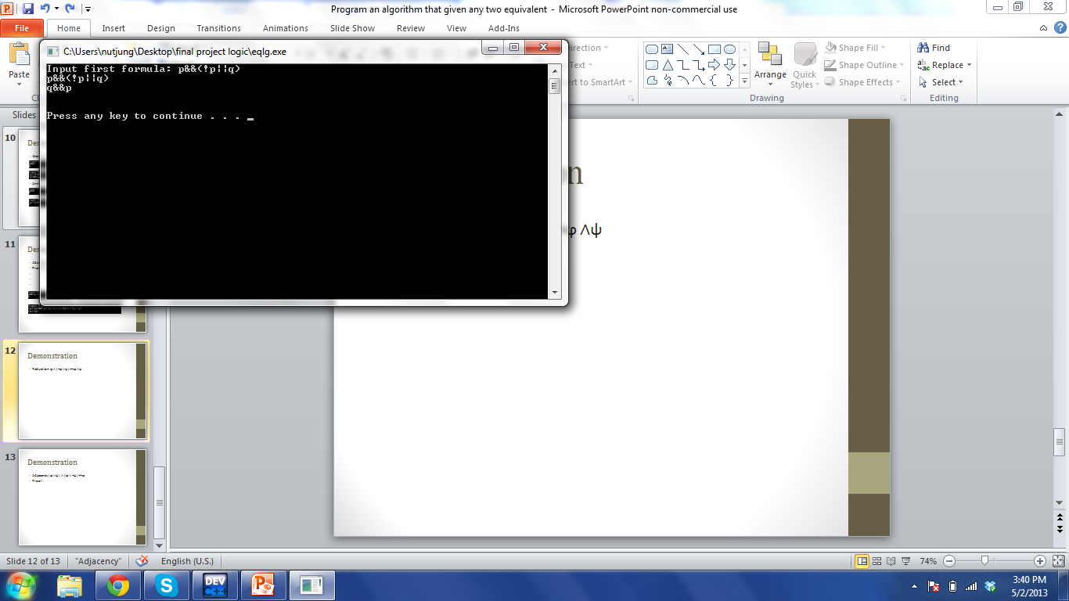
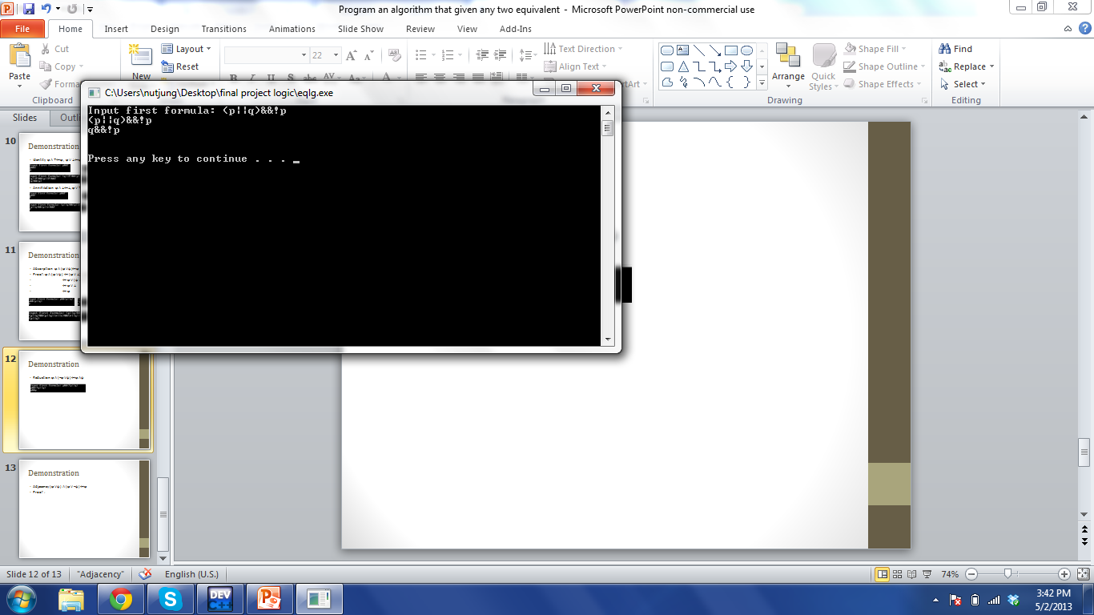
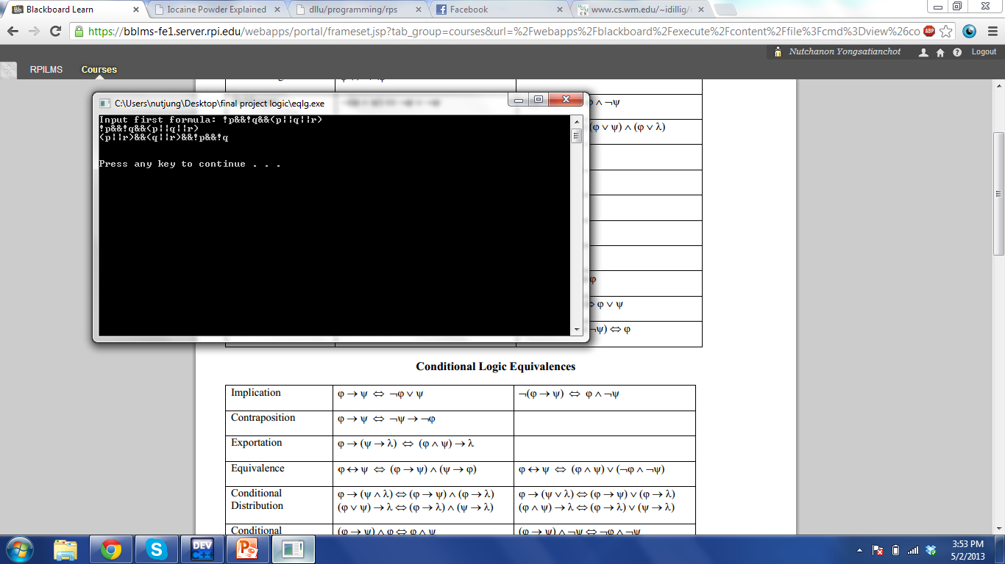

Demonstration
Reduction ϕ ∧ (¬ϕ ∨ψ)⇔ϕ ∧ψ
Note that if the formula is CNF, reduction only works for ϕ that is a atomic variable. The reason is that if ϕ is not a atomic variable, such as (p ∨ q), ¬ϕ which is ¬(p ∨ q), will not be in CNF or else it will be atomic variable anyway, ¬ϕ = ¬p ∧ ¬ q.
Example:

Slide 13
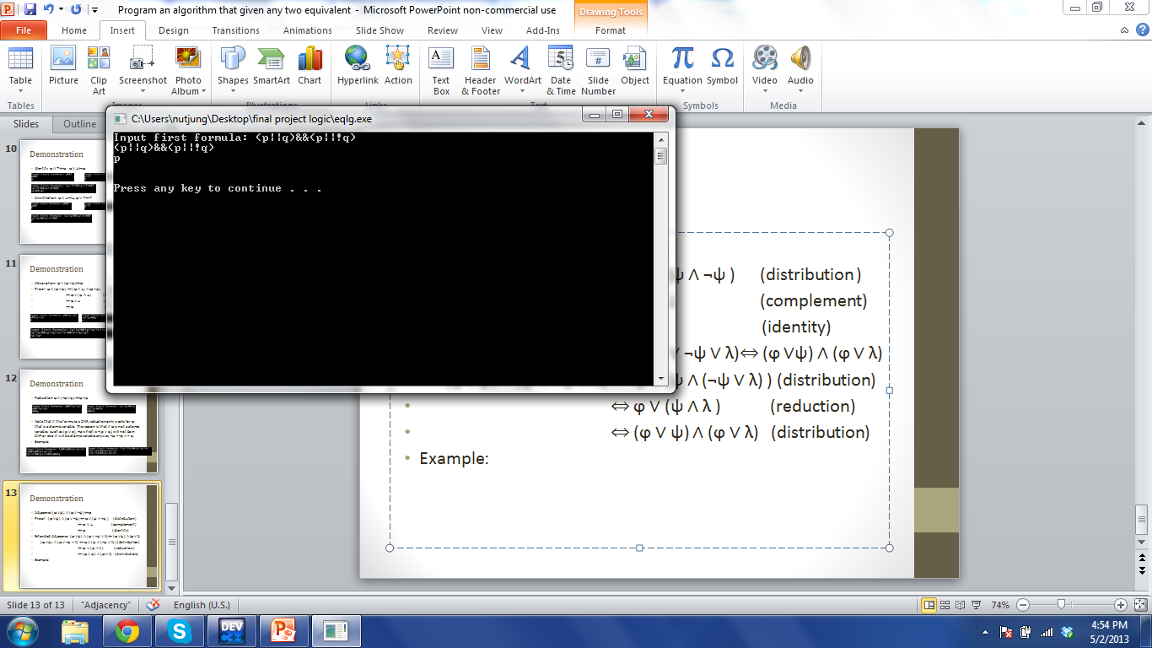
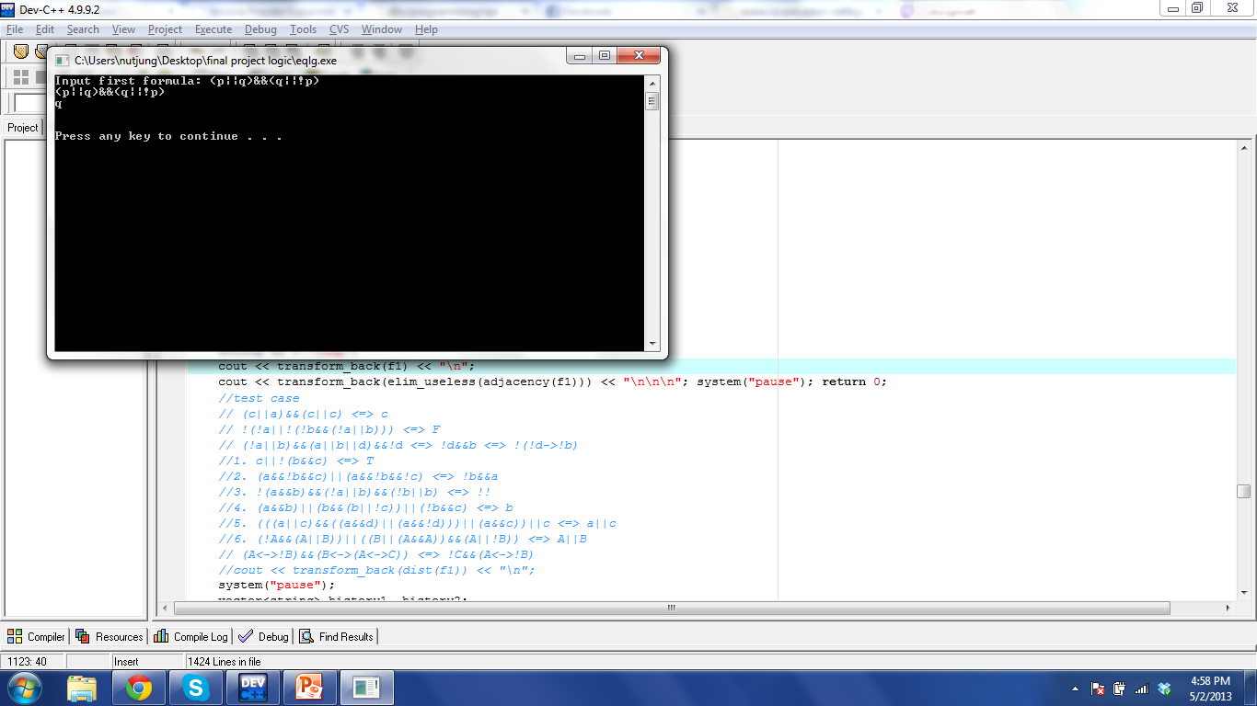
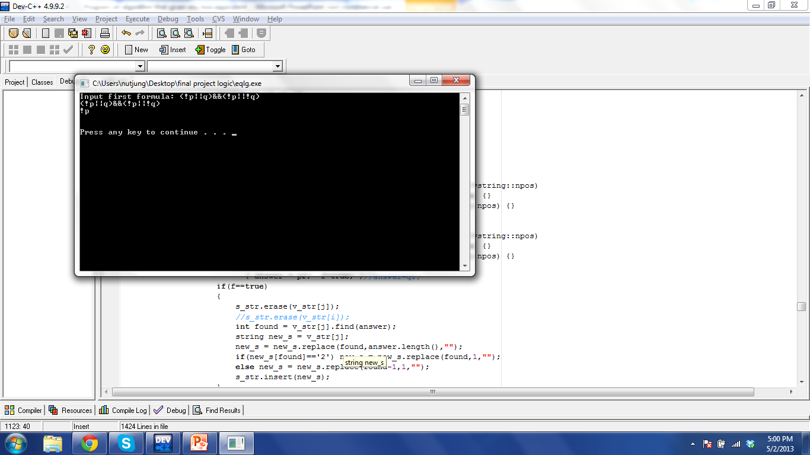

Demonstration
Adjacency (ϕ ∨ψ) ∧ (ϕ ∨ ¬ψ)⇔ϕ
Proof : (ϕ ∨ψ) ∧ (ϕ ∨ ¬ψ) ⇔ ϕ ∨ (ψ ∧ ¬ψ ) (distribution )
⇔ ϕ ∨ ⊥ (complement)
⇔ ϕ (identity)
Example:

Slide 14
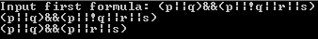
Demonstration
Extended Adjacency (ϕ ∨ψ) ∧ (ϕ ∨ ¬ψ ∨ λ)⇔ (ϕ ∨ψ) ∧ (ϕ ∨ λ)
(ϕ ∨ψ) ∧ (ϕ ∨ ¬ψ ∨ λ) ⇔ ϕ ∨ (ψ ∧ (¬ψ ∨ λ) ) (distribution)
⇔ ϕ ∨ (ψ ∧ λ ) (reduction)
⇔ (ϕ ∨ ψ) ∧ (ϕ ∨ λ) (distribution)
Example:
Notice that there is one case that have not been covered which is (ϕ ∨ψ) ∧ (¬ ϕ ∨ ¬ψ). This one actually is ϕ ↔ ψ.
I intend to left it in this form, (ϕ ∨ψ) ∧ (¬ ϕ ∨ ¬ψ) since my goal is simplest CNF.

Slide 15
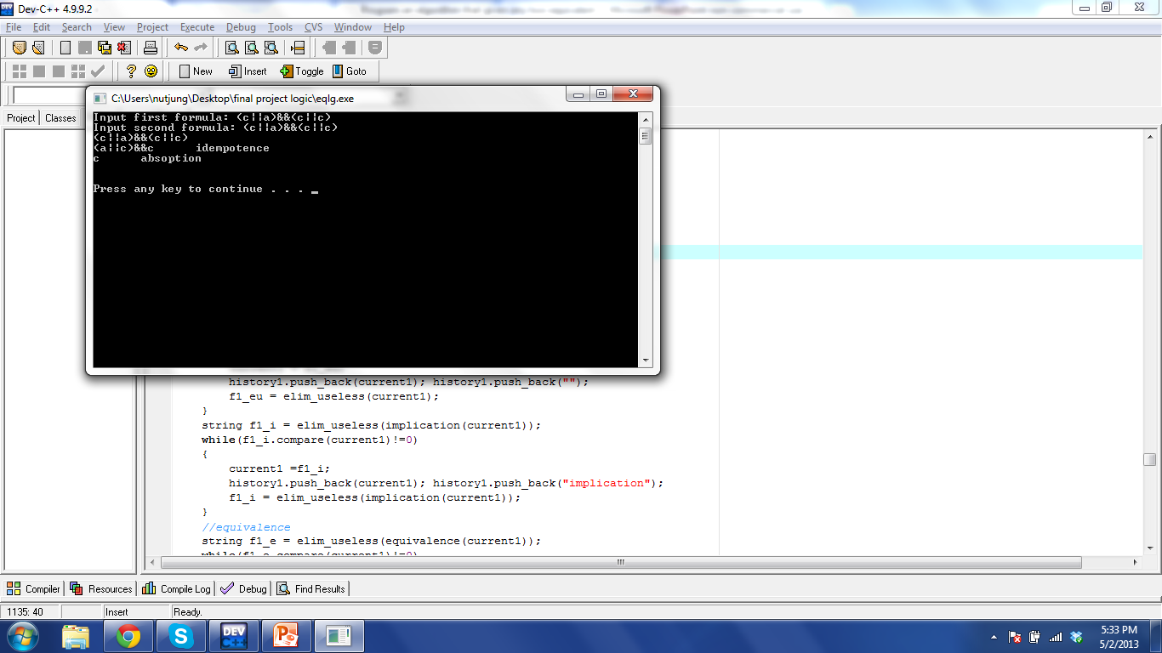
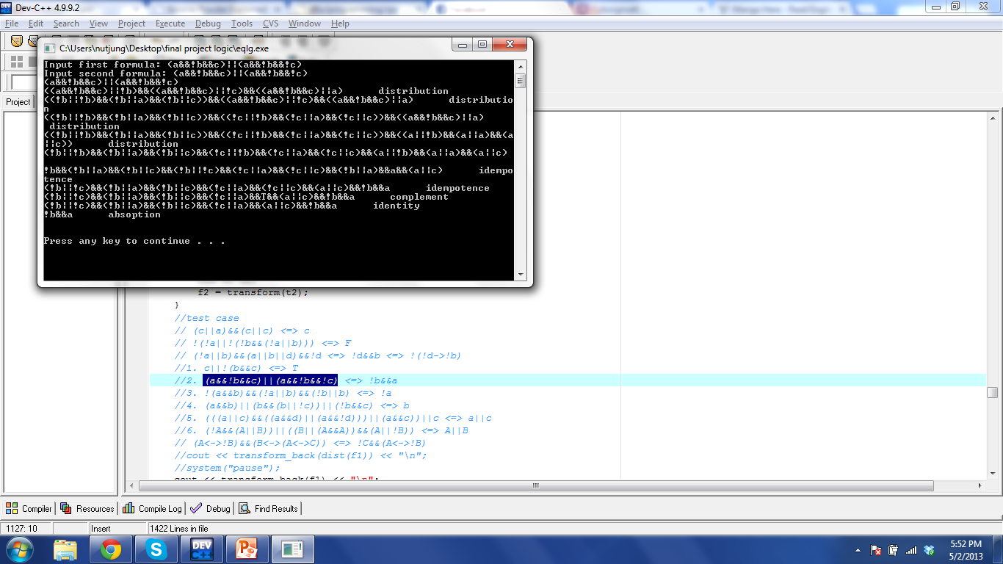
Demonstration - simplification
C ∨ ¬(B ∧C)
(A ∧ ¬B ∧C) ∨ (A ∧ ¬B ∧ ¬C)

Slide 16
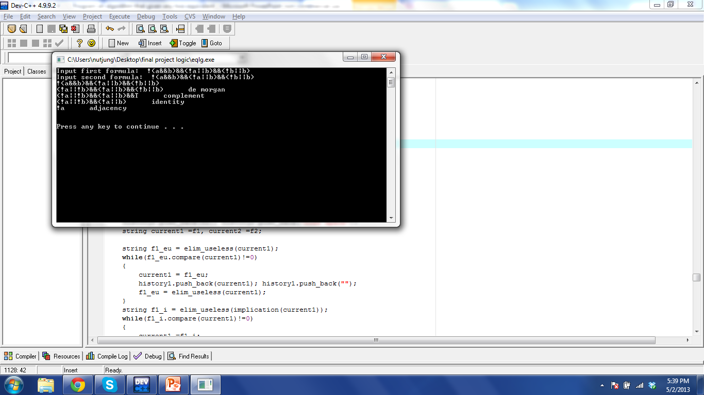
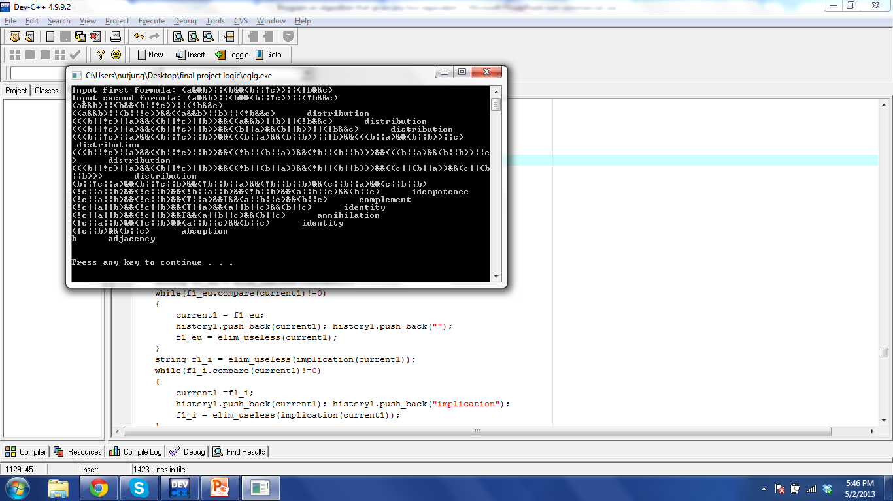
Demonstration - simplification
¬(A∧B) ∧ (¬A ∨ B) ∧ (¬B∨ B)
(A ∧ B) ∨ (B ∧ (B ∨ ¬C)) ∨ (¬B ∧C)

Slide 17
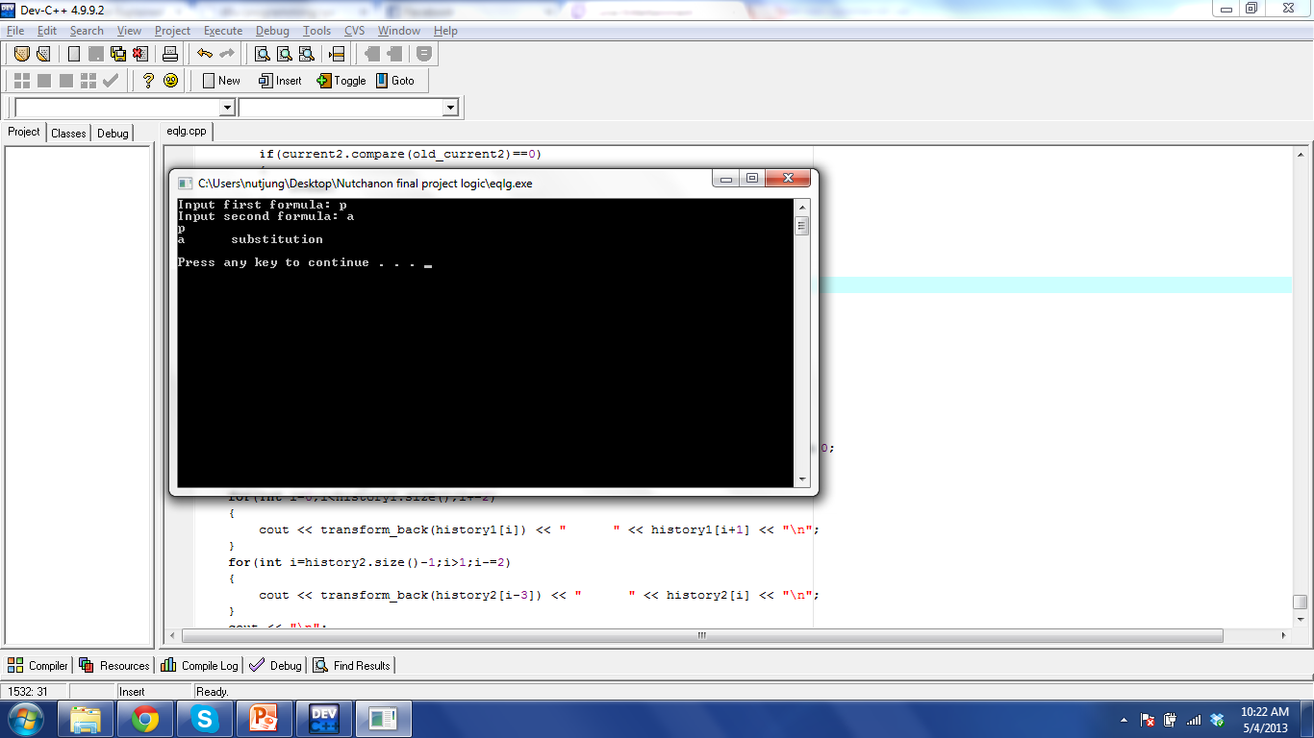
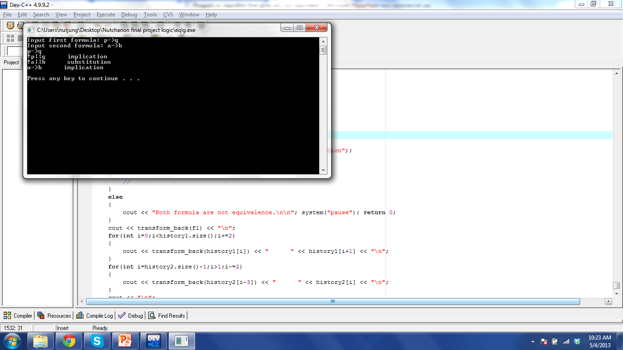
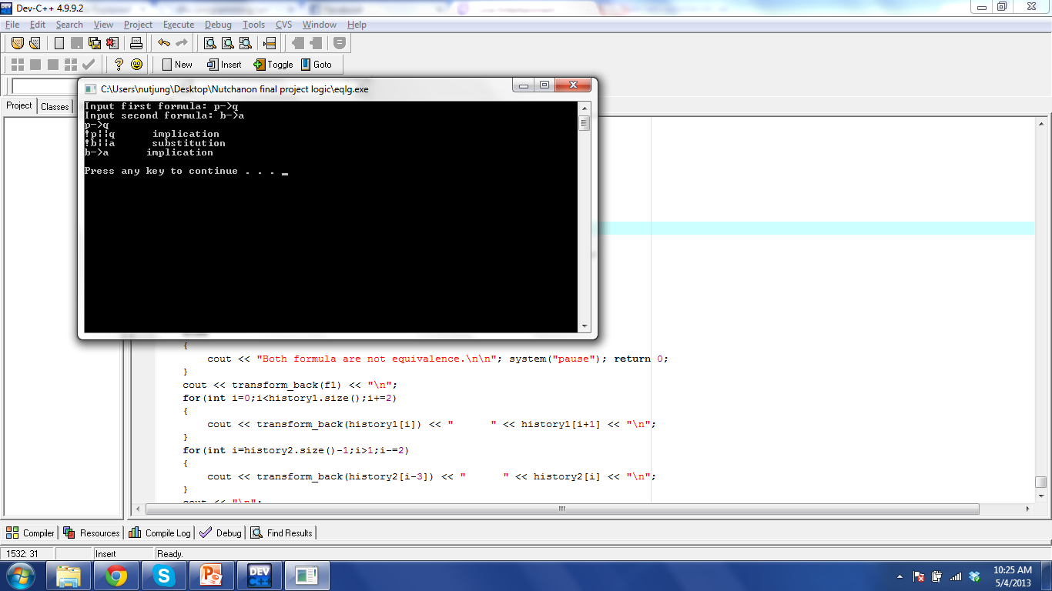

Demonstration – equivalence with different variable name

Slide 18
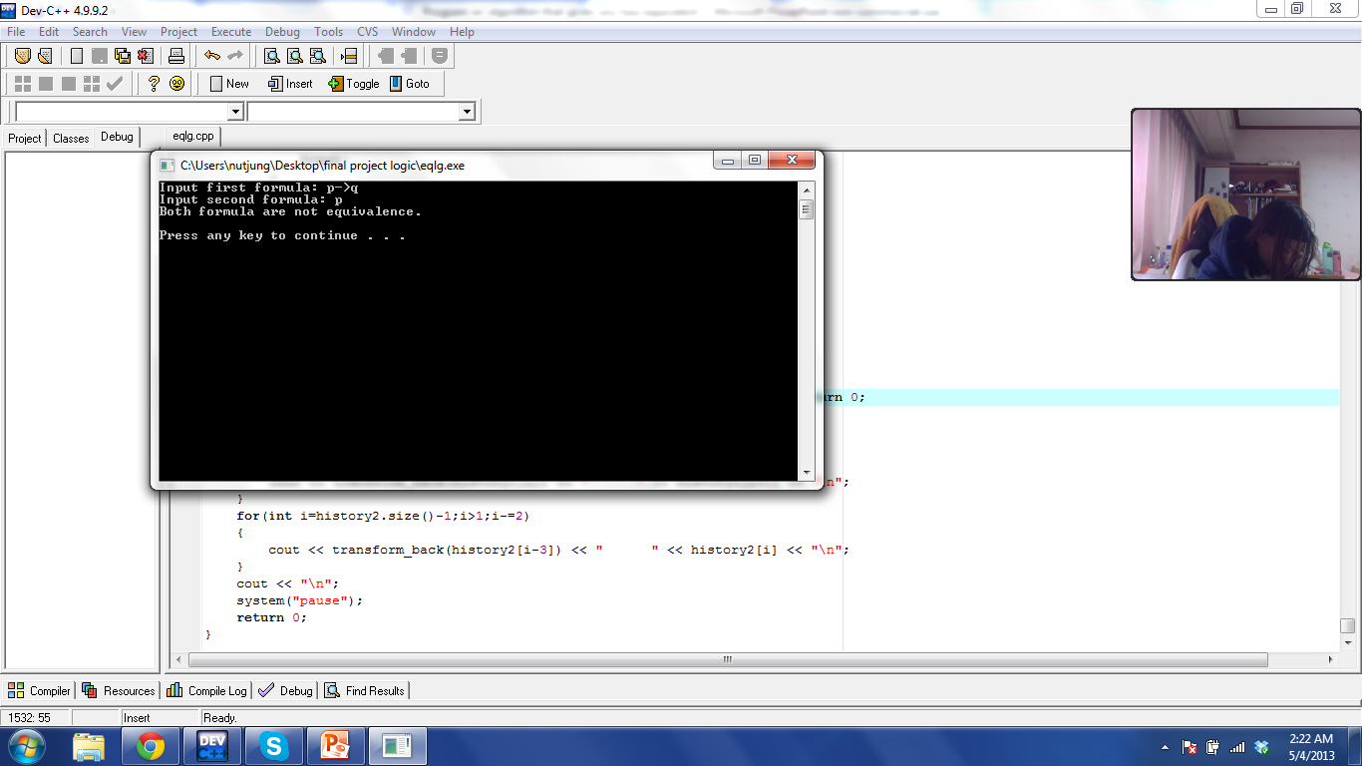
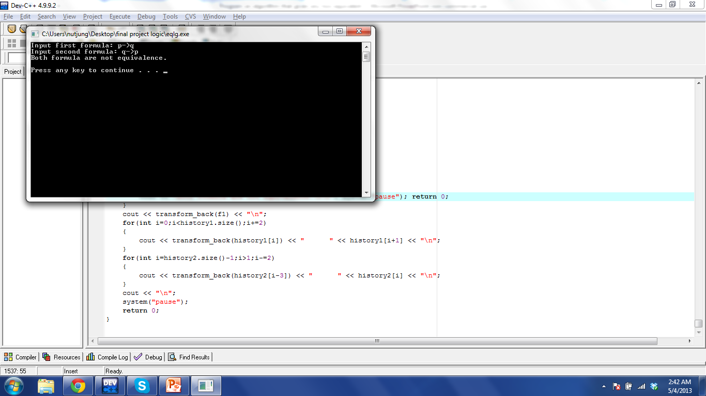
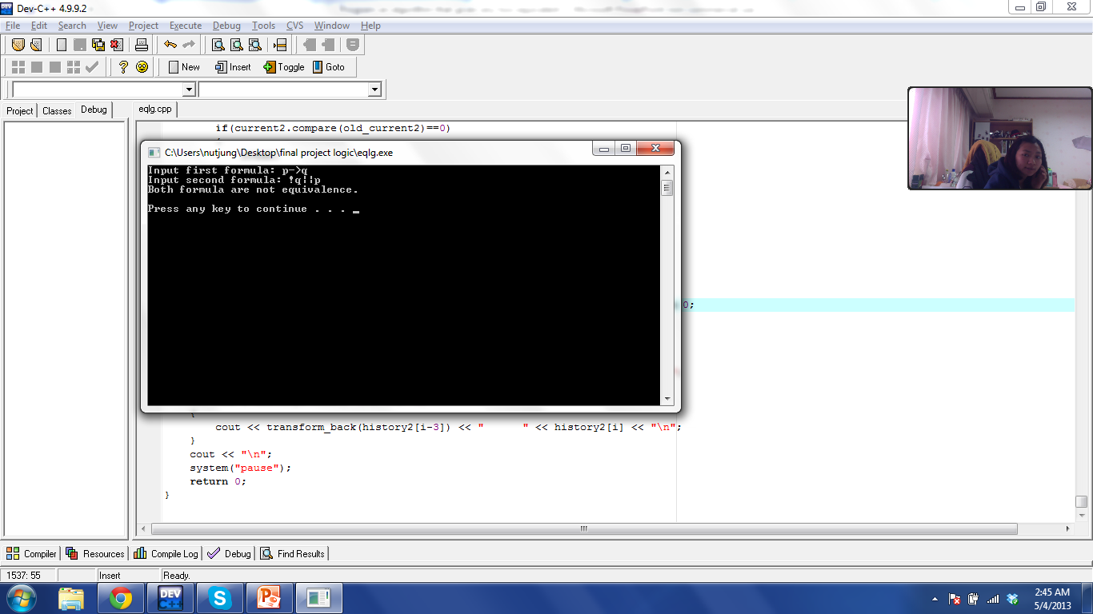
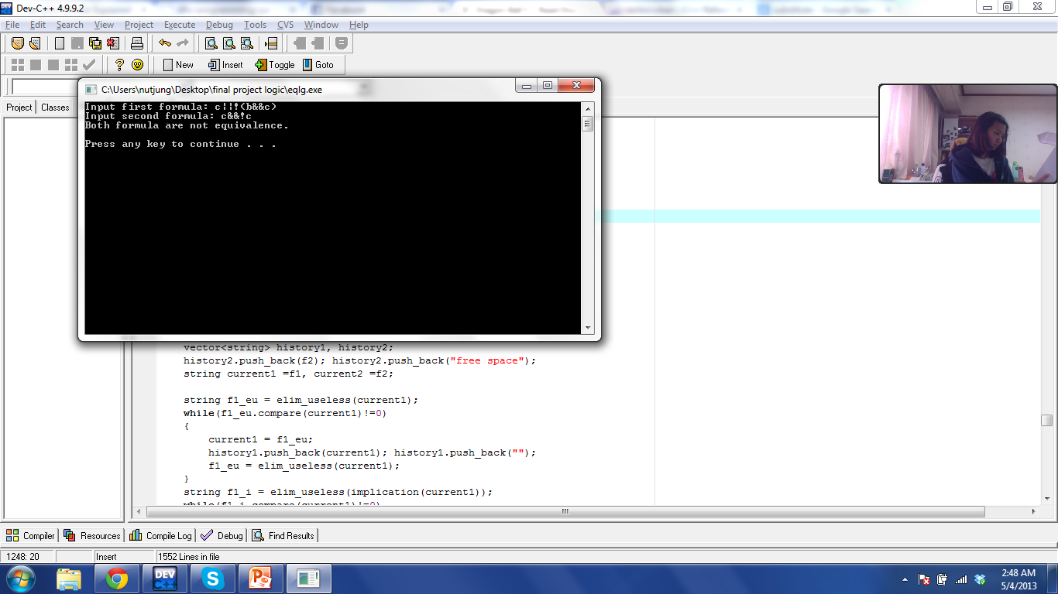
Demonstration – not equivalence

Slide 19
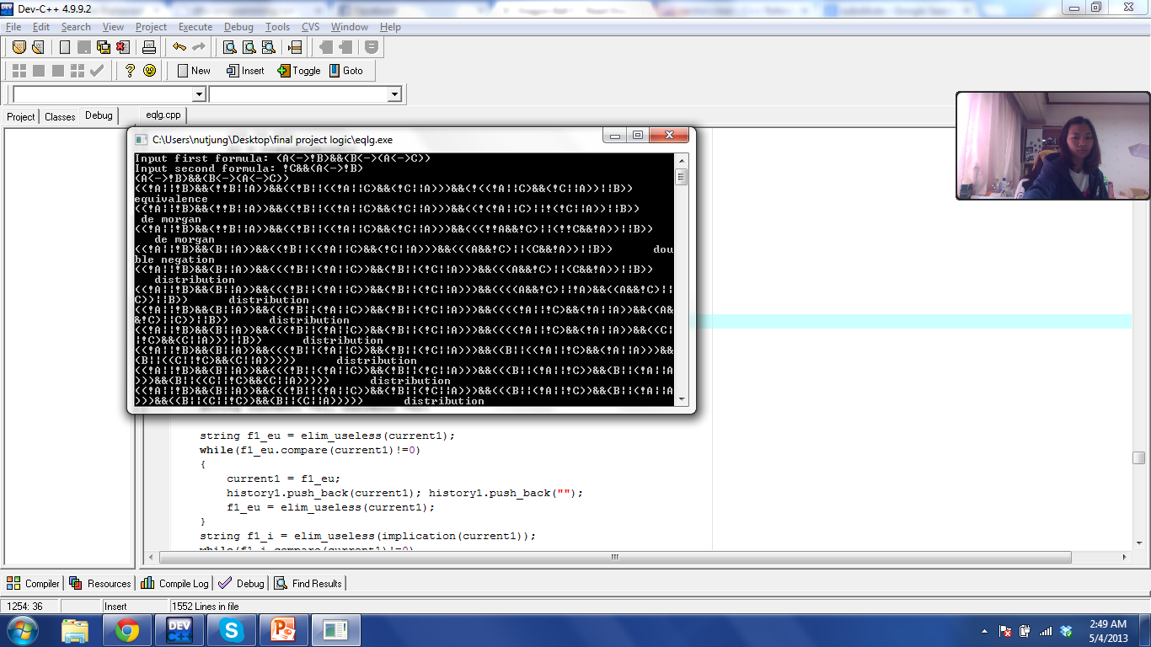
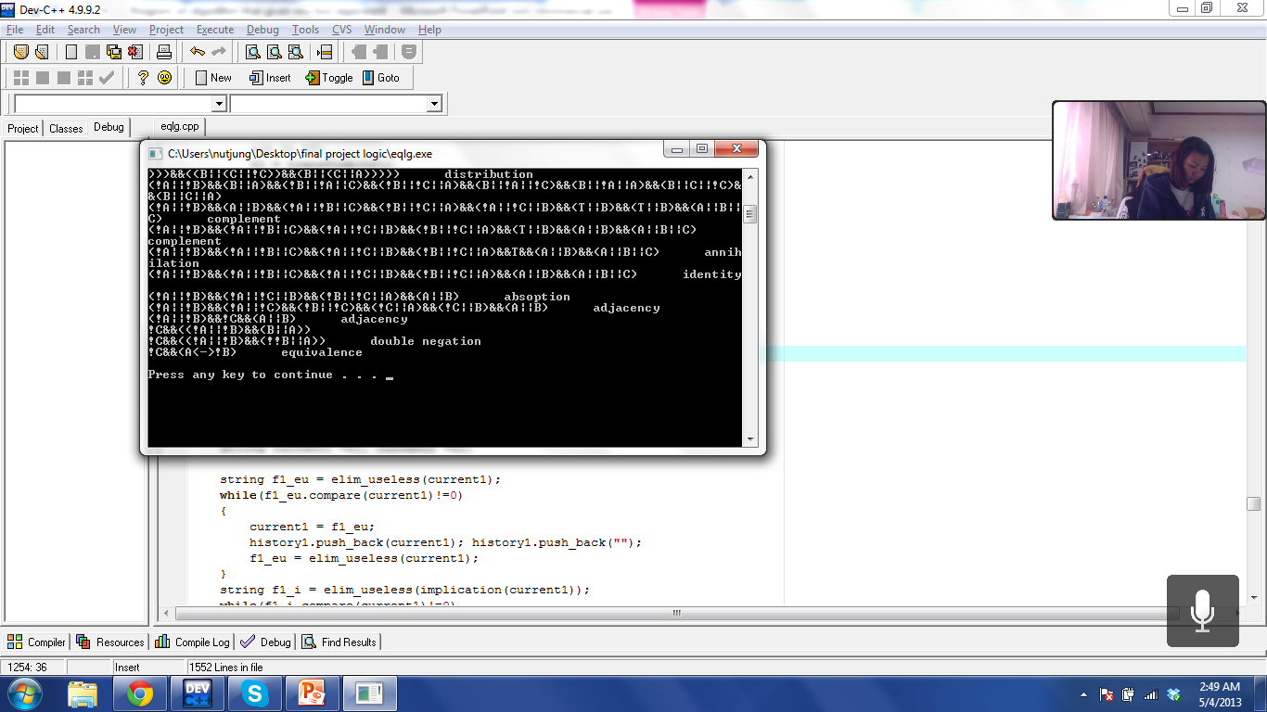
Demonstration
(A ↔¬B) ∧ (B ↔(A ↔C)) ⬄ (A ↔¬B) ∧ ¬ C

